Slide 1


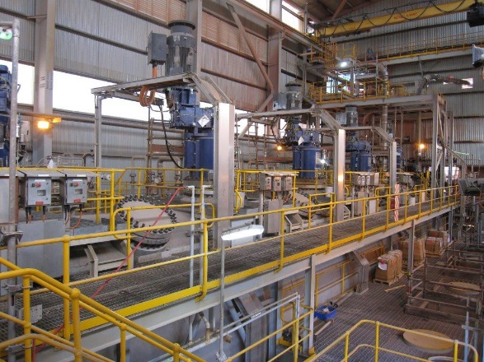
Innovation challenge: Can you identify the critical variables & relationships in the Lihir Autoclaves to optimise performance?
Challenge Description:
Pressure Oxidation (POX) is a complex process used in the treatment of sulphide gold ores to improve recovery rates. There are a large number of variables which all contribute to operational success; two measures of success are maximising solids tonnage throughput, and maximising sulphur tonnage throughput. These goals must be managed within constraints of upstream plant operation, laboratory data availability, feed pump limits, flow constraints, residence time, oxygen capacity, upper and lower temperature constraints, oxidation reduction potential (ORP) and cooling capacity.
User Story
The main challenge is identifying which process variables are most strongly related to the successful performance of the autoclaves and what are the optimal operating conditions allowing maximum tonnage throughput and sulphur throughput. What’s good and what’s not? A team of plant operators monitor the process continually; but are they making the best decisions to optimise throughput and maintain stability? Do they have the right information to make the decisions? As plant throughput increases, our ability to tolerate deviations from stable conditions gets less, and the edge of the stable operating window is nearing. We need to make the right decisions.
Relevant Data
Data will include a data dictionary and relations map
The primary data set covers 24 months of operation, including planned and unplanned shutdowns for four autoclaves. Feed rates, feed density, chemistry, oxygen flows, vessel pressures, temperatures, cooling water and agitation, together with other variables have been provided. Four periods of “good” performance have been identified to assist as a starting point. POX discharge chemistry also gives a guide to performance. Currently the Operations Team will push performance, often at times too far with respect to temperature (both hot and cold) or ORP to find their current limit. This can overstep the limits of stable operation and ultimately lead to reduced throughput while stability is regained.
Potential Areas to consider:
Can a system be developed to predict autoclave operating constraints and the optimum (or maximized) state which should be achievable, based on current performance and upstream plant feeding POX.
Can the upstream plant conditions be used to determine which variables are critical today and which are not?
Is there anything else we can do to improve productivity?
Additional or separate challenge: Can you develop an method of detecting when an autoclave sparge tube has broken off?
Challenge Owner: Sean Chaplin
Senior Metallurgist, Newcrest Mining Limited

